Slide 1
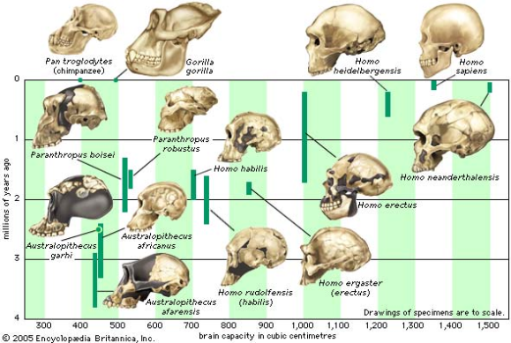
Primate Evolutionary Trends
Digits
Dentition
Vision
Cerebral Cortex
Gestation and Parental Care

Slide 2
Trends
Primates show a progression in changing characteristics, suggesting an evolutionary trend.
This can be seen in:
Digits
Dentition
Vision
Cerebral Cortex size
Gestation and Parental Care.

Slide 3
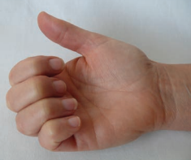

Digits
Limbs unspecialised in structure
Allows diversity in use
5 digits on each limb (pentadactyl)
Highly mobile
Prehensile
can curl around things to grip
Opposable thumbs (and big toes for some)
Thumb can cross palm to touch other fingers

Slide 4
Digits – degree of opposability
Varies between species
Depends on relative length of first digit
Most primates also have opposable big toe
Humans are an exception
Feature a disadvantage when bipedal – weight distribution
Humans have the longest thumb
Allows manipulation of materials.

Slide 5
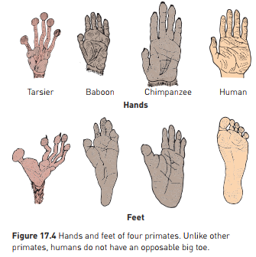

Slide 6
Digits – nails vs claws
Tips of digits modified for better grip in trees
Nails instead of claws
Nails allow better grasping
Evolved from claws that became flattened
Some primates still have claws – Aye-Ayes and Lemurs
Lemurs: “toilet claw” for grooming/scratching
Aye Ayes -
Digits also have more sense receptors for feedback when gripping and manipulating
Friction ridges “fingerprints” increase grip

Slide 7
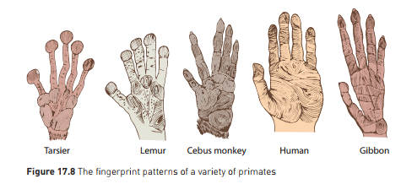
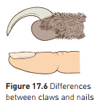

Slide 8
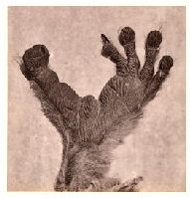
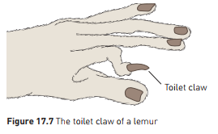
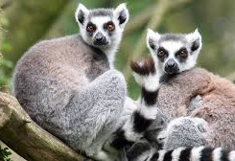
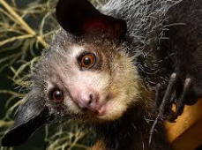
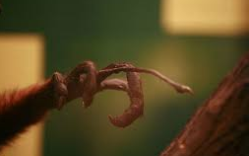

Slide 9
Digits – mobility
Humans – very mobile digits
Short broad hand, short straight fingers, long strong thumb
Allows precision grip
Writing
Sewing
Construction
True opposable thumb
Only in Old World monkeys eg baboons, mandrills, macaques; apes; humans

Slide 10
Dentition (Teeth)
Evolutionary changes can be seen to teeth
Can look at Dental Formula
Gives number of each type of tooth on each jaw quarter
Primitive mammals: 3:1:4:3 (incisors: canines:premolars:molars)
Decrease in number of teeth in primates compared with early mammals.
Probably related to gradual reduction in face and jaw size
Lemurs and lorises: 36 teeth 2:1:3:3
Tarsiers: have lost 2 incisors from lower jaw: 2:1:3:3/1:1:3:3
New World Monkeys – evolutionary trend for missing third molar
Old World Monkeys, Apes and Humans: 32 teeth 2:1:2:3

Slide 11
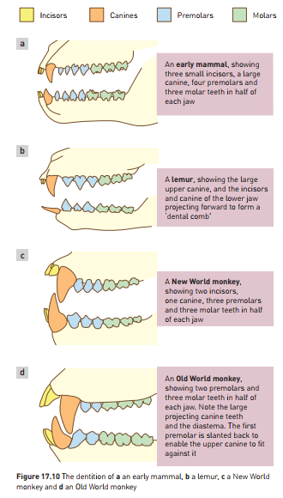

Slide 12
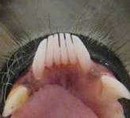
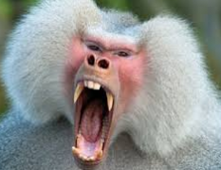
Dentition (Teeth)
Variability and specialisation in tooth form
Lemurs and Lorises: lower incisors – dental comb:
Grooming
Old World Monkeys: large, sharply pointed canines
Longer than surrounding teeth
Diastema on top jaw to fit lower canine when mouth shut
Lower premolar slanted back with sharp edge to sharpen upper canine

Slide 13
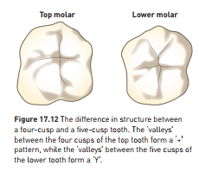
Dentition (Teeth)
Molar teeth show little change from early mammals
Generalised diet, generalised teeth
Three cusp molar in early mammals
Four cusp molar in Old World monkeys
Apes and humans: 5 cusp molar – evolved due to fruit in diet?

Slide 14
Dentition (Teeth)
Fossil teeth often found due to hard enamel preserving them
Can be used to indicate diet but caution as some adaptations are not due to diet:
Dental combs eg lemurs and lorises
Large canines in Old World Monkeys – defence and social disply

Slide 15
Vision
Primates have evolved emphasis on vision
Due to arboreal lifestyle (in trees)
Decreased emphasis on olfaction (smell)
Emphasis on vision as an advantage has led to change in skull shape:
Nose and snout smaller and flatter
Brain case larger
Less use of nose and snout to sense environment, greater use of eyes
Compare Lemurs who use snout to investigate an object vs apes who use hands and eyes
Movement of eyes to face forward
Allows stereoscopic (3D) vision, accurate distance perception essential when leaping between branches
Field of view narrower – could be disadvantage re: predators – compensated by having mobile head and neck – can “look around”
Bony socket protects eyes
Retina – rods and cones
Rods important for vision in dim light
Cones- visual discrimination and colour vision
Neural connections between eye and brain also improved
Acute vision
Coordination between eyes.

Slide 16
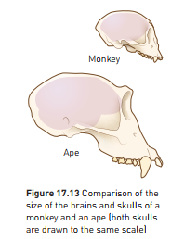
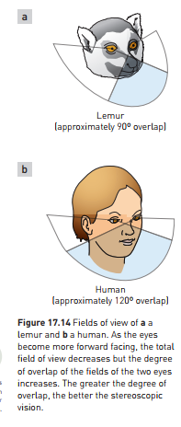
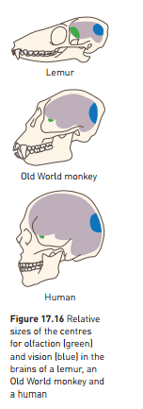

Slide 17
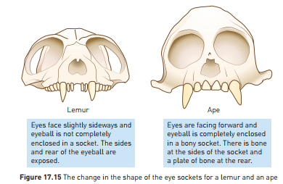
Vision
Can see evolution of eye socket in comparing lemurs and apes:
Brain regions larger for vision, smaller for olfaction as evolution moves closer to humans

Slide 18
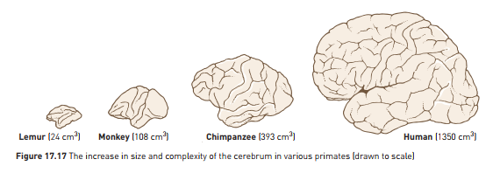
Cerebral Cortex Size
Progressive increase in cerebrum as evolution closer to human
Region of brain concerned with “higher-order” functions
Reasoning
Memory
Manipulation and construction
Vision
Language
Noticeable trend from lemurs to monkeys to humans:

Slide 19
Cerebral Cortex Size
Large cortex compared to body size probably an advantage in arboreal environment:
Accurate visual and tactile perception
Coordination and integration of stimulus and response
Vision produces large amount of info that must be processed and stored
Cortex increasingly convoluted (folded)
Increases surface area by 50% in humans, compared with no folds
Increased cerebral cortex size has influenced how primates live
Nomadic movement
Food location
Tool construction and use
Variety of behaviour responses – behavioural flexibility
Ability to reason and problem solve
Skull size more large and rounded in humans due to larger brain size.

Slide 20
Gestation and Parental Care
Evolutionary trend in reproductive physiology and behaviour
Generally single offspring at one time
Adaptation to arboreal life?
Long period of growth and maturation with high parental care
Due to increased brain and skull size – need to birth before baby’s head gets too big
Primates are placental mammals
Offspring develop in uterus, receive nourishment from mother’s blood stream via the placenta
Apes and humans – more efficient placenta
Gestation (pregnancy) is long in primates
Tarsier: 1 offspring, 6 month gestation
Rodent: 6+ offspring, 3 week gestation

Slide 21
Gestation and Parental Care
Long period of parental care
Increases in length as more closely related to humans
Lemurs: young weaned at 5 months
Apes: young feed from mother for 3-4 years, need protection and guidance for 6+ years
Associated delay in maturation
Sexual maturity later in apes and humans than lorises and monkeys
Period of learning extended as a result
Allows ideas and skills to be passed on
Reduces number of offspring per lifecycle – time and effort must be invested in care as a trade-off

Slide 22
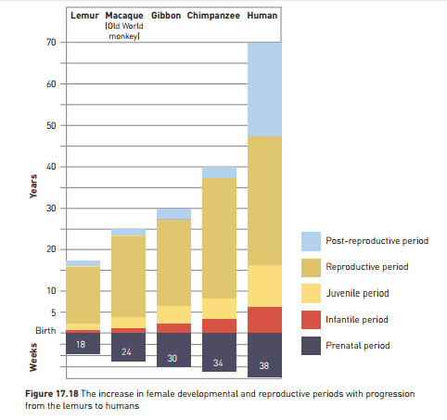

Slide 23
